Slide 1

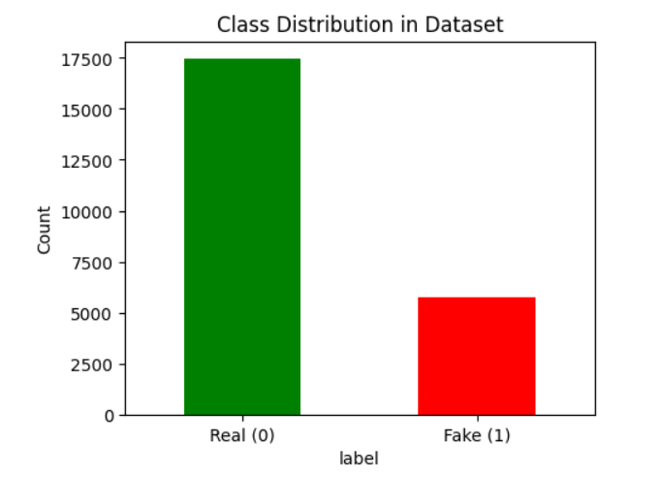
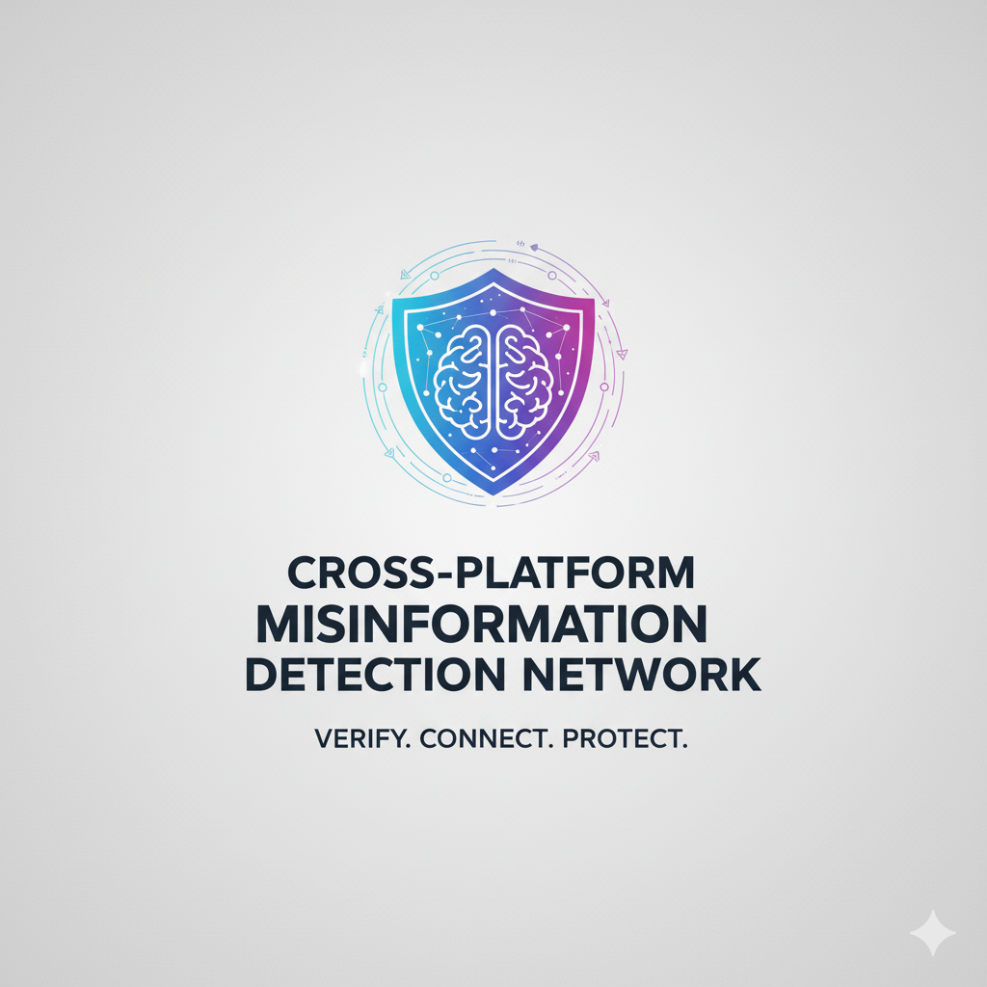
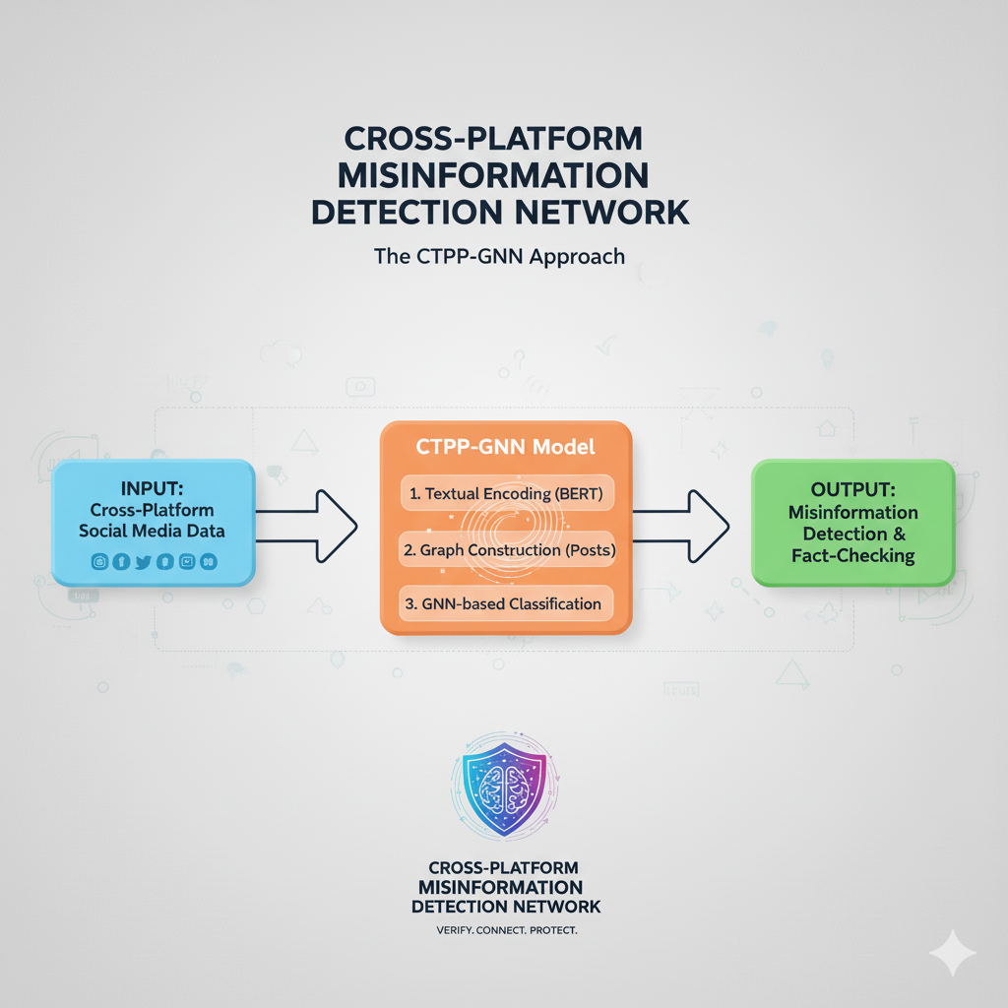
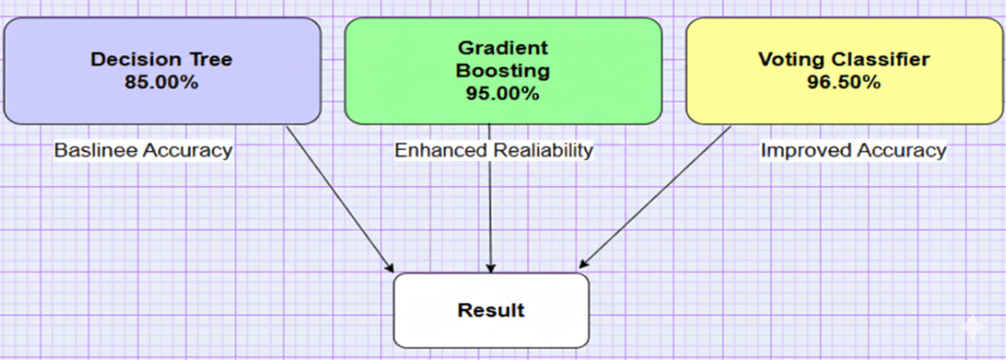


CROSS-PALTFORM MISINFORMATION DETECTION NETWORK
Team:
G. Sai Krishna Priya 2203A52085 S. Gayathri 2203A52120
V. Divya 2203A52130 L. Charan 2203A52098
INTRODUCTION
RESULTS
Misinformation spreads quickly across various social media platforms, which makes it hard to keep information accurate. Traditional detection systems that focus on a single platform do not capture the complicated ways misinformation moves between platforms. This project presents CTPP-GNN, a new Cross-Platform Text Propagation Graph Neural Network. It is designed to effectively detect misinformation by combining content, user interaction, and timing of propagation patterns across platforms like Twitter, Reddit, and Facebook.
The CTPP-GNN achieved an accuracy of 94.7%, surpassing baseline models like BiLSTM, CNN, and standard GCN.
Precision: 92.3% | Recall: 95.1% | F1-score: 93.7%
The model effectively recognized misinformation propagation patterns that traditional text-only models overlooked.
Visualization of learned embeddings clearly showed a separation between real and fake clusters.
The feature importance analysis showed that text credibility, user engagement patterns, and cross-platform propagation behavior were the main factors affecting the model’s predictions. The proposed CTPP-GNN model provided a good balance across all evaluation metrics. This demonstrated its strength and flexibility for detecting misinformation on various social media platforms. In conclusion, the system proved to be highly reliable and reproducible, suggesting its potential for real-world use in monitoring and preventing misinformation across platforms.
METHODS
CONCLUSION
DISCUSSION
The study highlights the difficulties in identifying misinformation that spreads differently across platforms like Twitter, Reddit, and Facebook. Traditional models that focus on a single platform often miss important changes in context, variations in language, and different behaviors in how information spreads. The proposed CTPP-GNN (Cross-Platform Text Propagation Graph Neural Network) effectively models content similarity, timing of information spread, and user interaction graphs. This allows the detection system to learn shared patterns of misinformation across different platforms. By combining semantic embeddings and features based on how information propagates, the model shows better generalization, reduces false positives, and captures cross-network connections that other methods miss.
1. Data Collection: Posts and comments were collected from Twitter, Reddit, and YouTube using official APIs.
2. Preprocessing:
Removed URLs, hashtags, and stopwords.
Tokenized and lemmatized using SpaCy.
Extracted features using TF-IDF and BERT embeddings.
3. Model Architecture:
Implemented multiple models: CTPP-GNN(Proposed Model), Random Forest, LSTM, and GRU.
Proposed a Hybrid Ensemble Model that combines LSTM and GRU predictions.
4. Evaluation:
Split the dataset into 80% for training and 20% for testing.
Measured performance using Accuracy, Precision, Recall, and F1-score.
The experimental results confirm that CTPP-GNN significantly surpasses baseline models in accuracy, precision, recall, and F1-score. An analysis of feature importance showed that text credibility, source reliability, and engagement between platforms were key factors in detecting misinformation. Overall, the model provides a strong and flexible solution that can adjust to new platforms and changing misinformation trends. Future improvements may include real-time detection systems and analysis of multiple types of content (text, images, and videos) to further boost performance. The system's ability to work across different platforms makes it a valuable tool for monitoring misinformation and improving digital safety.

